Slide 1
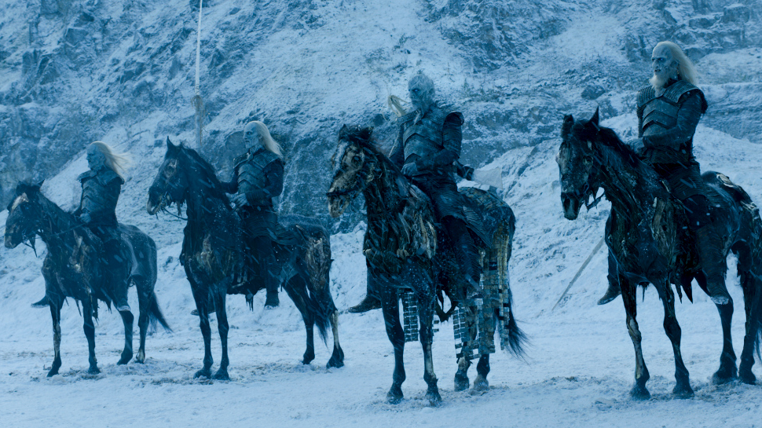
Erl Of Thrones
Winterl is coming…

Slide 2

Winterl is Coming
Kobi Eini
Adir Ben Azarya

Slide 3
Simulation Overview
Simulation of Last battle of Game of Thrones
Based on Erlang + OTP + Graphics with WxWidgets
Aim: Kill the knight king
Features:
Place 3 characters anywhere on the screen
Every character moves randomly on the screen

Slide 4
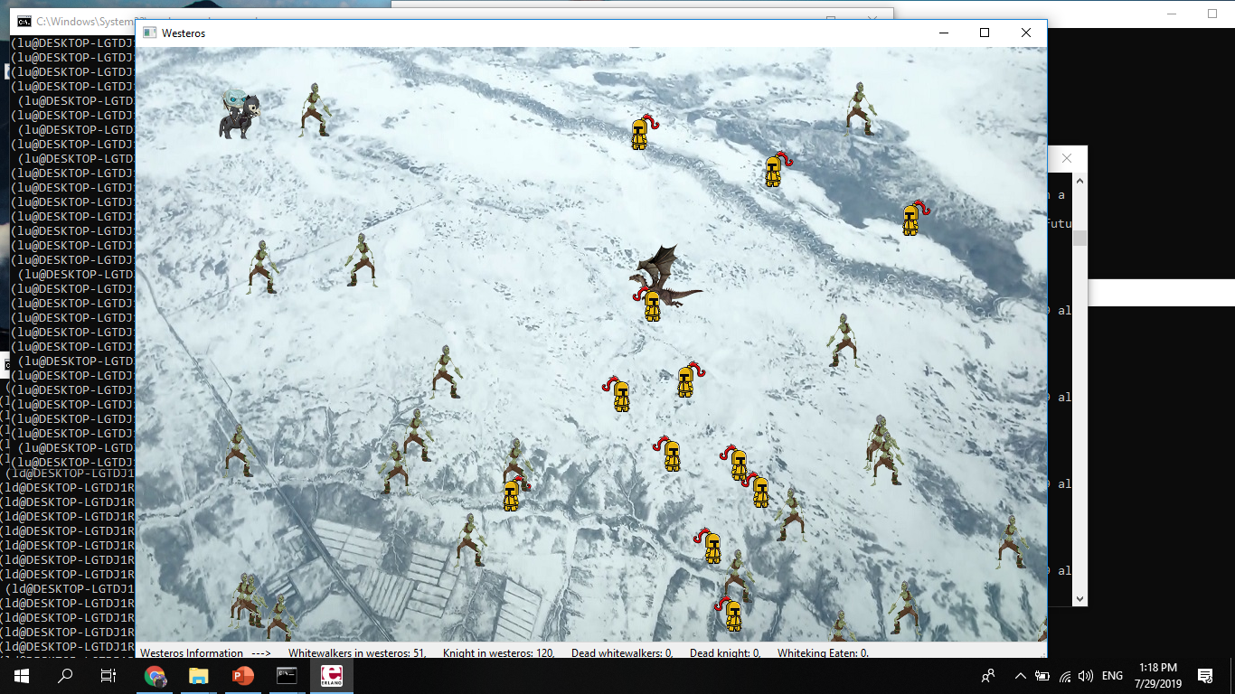
Screenshot

Slide 5
Design Architecture
Simulation
Wx_server
Simulation Supervisor
Square_server
gen server
Square_server
gen server
Square_server
gen server
Square_server
gen server

Slide 6
Distributed applications
Fail Over
Take Over
Node
lu
Node
ru
Wx_server
Node
ld
Node
rd
Fail Over
Take Over

Slide 7
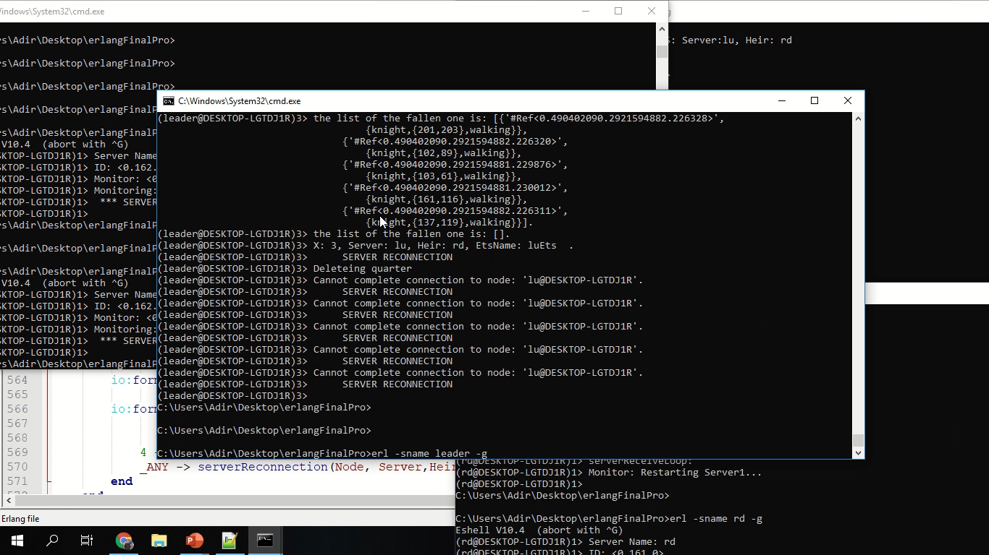

Slide 8
Hierarchy Of supervision
Uses native OTP architecture.
The Supervisor is:
Wx_server.
Manages each crash according to the previous diagram.
Lu ⬄ Rd, Ru ⬄ Ld.
We used this hierarchy to:
Ensure proper start and termination of each process
Ensure proper re-start of crashed processes

Slide 9
Data Base Integration
During application start, ETS DB is created on all nodes within distribution.
Updates concurrently throughout the simulation.
Each table is responsible of different area:
Updating square servers characters.
Updating gui of Wx server.
Updating square servers in case of crash.
Linking the whitewalkers in case position change of the knight king.
Each update of the database updates for every participating node.

Slide 10

Challenges
Implementation of simulation through OTP modules.
Getting started with WxWidgets - not much helpful documentation.
Implement back up system and treat each crash properly.
Using a distributed system to load the simulation.

Slide 11


Advantages and Disadvantages
ADVANTAGES
Easily controlling processes by linking and monitoring them.
Supervisors ensure simple monitoring of running processes.
DISADVANTAGES
There is no convenient workspace which makes it difficult to debug the simulation.
No helpful documentary about WxWidgets.

Slide 12
Youtube link:
https://docs.google.com/forms/d/e/1FAIpQLSc6LjxoC26dtWA-BgMalhtC8jR3uMK5M3pdCqk4rNUPje9U_A/viewform?usp=pp_url&entry.1454549342=adirben@post.bgu.ac.il&entry.1515595736=Erl+of+Thrones&entry.684031837=Adir+Ben+Azarya&entry.1082107906=203904610&entry.1992906213=Kobi+Eini&entry.997842463=201553245&entry.1698857208=https://www.youtube.com/watch?v%3D7IML6wkIMX0

